Slide 1
Final presentation
IS203 - Software engineering
18th Nov 2015
G4 - T6
Wang Shu Wei (PM)
Tan Yong Siang
Jeremy Lee
Jason Wu
Wu Wei

Slide 2
agenda
Schedule
Metrics
Use of GIT
Takeaways

Slide 3
Schedule

Slide 4
ACTUAL VS PLANNED
15-Sep
26-Sep
13-Oct
24-Oct
27-Oct
Iteration 1(12 days)
Iteration 2 (12 days)
Iteration 3 (12 days)
Planned
Actual
29-Sep
10-Oct
12-Oct Buffer Activated
2 days Buffer
2 days Buffer
Schedule
Metrics
Use of GIT
Takeaways

Slide 5
ACTUAL VS PLANNED
27-Oct
7-Nov
Iteration 4(12 days)
Iteration 5 (8 days)
Planned
Actual
10-Nov
17-Nov
18-Nov
2 days Buffer
1 day Buffer
Schedule
Metrics
Use of GIT
Takeaways

Slide 6
FUNCTIONALITIES UPDATE
No dropping/ addition of functionalities
Framework: Model View Controller (MVC)
Time-Boxing
Schedule
Metrics
Use of GIT
Takeaways

Slide 7
ExTERNAL LIBRARIES
gson-2.3
Is203-jwt-v2
json-smart-1.2
nimbus-jose-jwt
opencsv-3.5
Schedule
Metrics
Use of GIT
Takeaways

Slide 8

Break down of coding task
Functionalities | SHUWEI | WUWEI | YONG SIANG | JASON | JEREMY
Login & Logout
Bootstrap
Basic App Usage Report
Top-k Usage Report
Smartphone Overuse Report
Schedule
Metrics
Use of GIT
Takeaways

Slide 9
Break down of coding task
Functionalities | SHUWEI | WUWEI | YONG SIANG | JASON | JEREMY
Dual Interfaces
Loading Location Data
Deletion of Data
Smartphone Usage Heatmap
Social Activeness Report
Improve UI
Schedule
Metrics
Use of GIT
Takeaways

Slide 10
PROJECT MANAGER SCHEDULE
ITERATION | NAME | MILESTONE
1 | JEREMY | Supervisor Meeting 1
2 | WU WEI | PM Review
3 | JASON | Supervisor Meeting 2
4 | YONG SIANG | Supervisor Meeting 3 UAT
5 | SHUWEI | Final Presentation
Schedule
Metrics
Use of GIT
Takeaways

Slide 11
Programming hours
69.67
68.3
63.41
66.54
60.79
18%
21%
21%
19%
20%
Wu Wei
Shuwei
Jason
Yong Siang
Jeremy
TOTAL: 328.71
AVERAGE: 64.74

Slide 12
Non-Programming hours
34.5
30.5
24.5
24.5
21.5
16%
18%
25%
23%
18%
Wu Wei
Shuwei
Jason
Yong Siang
Jeremy
TOTAL: 135.5
AVERAGE: 27.1

Slide 13
total hours
102.8
94.17
93.91
91.04
82.29
18%
20%
22%
20%
20%
Wu Wei
Shuwei
Jason
Yong Siang
Jeremy
TOTAL: 464.21
AVERAGE: 92.84

Slide 14
Fair distribution of work
Each member took on a role as a Project Manager
Total non-coding hours are generally even
Total coding hours are generally even
Fair share of programming task
Schedule
Metrics
Use of GIT
Takeaways

Slide 15
metrics

Slide 16
Pair-Programming Metrics 1st Iteration
Schedule
Metrics
Use of GIT
Takeaways

Slide 17
Pair-Programming Metrics 2nd Iteration
Schedule
Metrics
Use of GIT
Takeaways

Slide 18
Pair-Programming Metrics 3rd Iteration
Schedule
Metrics
Use of GIT
Takeaways

Slide 19
Pair-Programming Metrics 4th Iteration
Schedule
Metrics
Use of GIT
Takeaways

Slide 20
Pair-Programming Metrics 5th Iteration
Schedule
Metrics
Use of GIT
Takeaways

Slide 21
bug metrics

Slide 22
Iteration 4
More functions to integrate and test
Bug score was relatively high due to lack of testing prior to deployment
Action: Discuss issues identified as a group before proceeding to debug code to promote understanding of root causes
Schedule
Metrics
Use of GIT
Takeaways

Slide 23
Iteration 5
After experiences from Iteration 4, we tested the individual functions completely before deployment
Bug score was relatively low due to extensive regression testing prior to deployment
Schedule
Metrics
Use of GIT
Takeaways

Slide 24
Iteration 5
Found a very interesting bug that we took hours to debug
Iterator vs For Loop in SE 7
Schedule
Metrics
Use of GIT
Takeaways

Slide 25
Challenges faced
Challenges | Solutions
Estimating the time for each task | Understand requirements clearly and infer from previous PP tasks to give more accurate estimations for future tasks
Schedule
Metrics
Use of GIT
Takeaways

Slide 26
Use of git

Slide 27
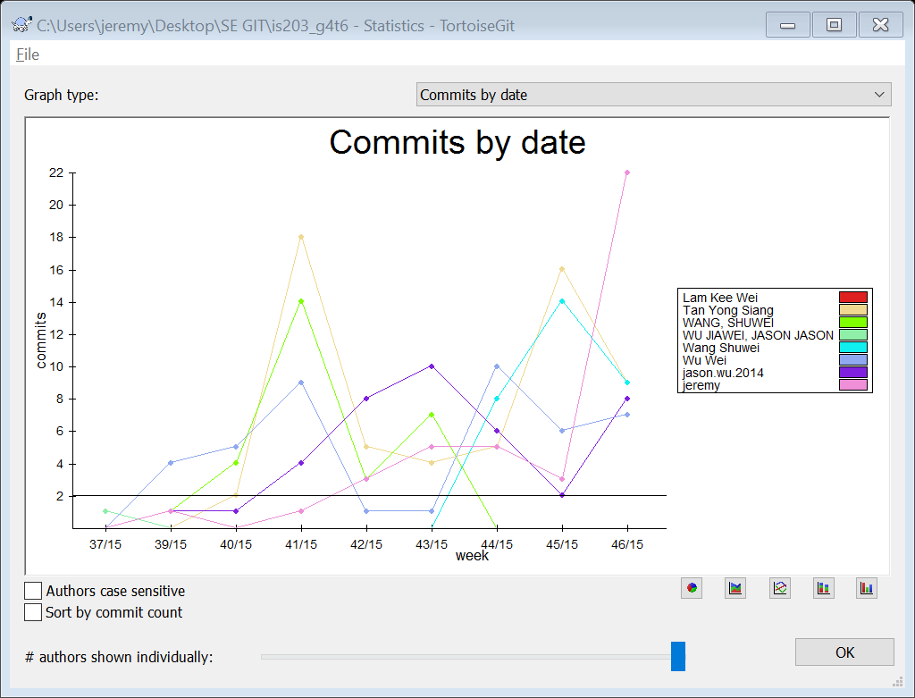
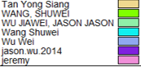
COMMIT BY DATE
CONSISTENT USE!

Slide 28
Commit by author
60
59
43
41
40
Wu Wei
Shuwei
Jason
Yong Siang
Jeremy

Slide 29
Reason for difference
Some of us do incremental commits while some others commit only once at the end
Some of us were actively resolving git conflicted files in the beginning
Schedule
Metrics
Use of GIT
Takeaways

Slide 30
Audit result
Audit | Iteration 1 | Iteration 2 | Iteration 3 | Iteration 4 | Iteration 5
Out of session | 0 | 17 | 6 | 12 | 1
Not familiar with the usage of Git, have to resolve a lot of conflicts
Web UI mistaken as non-programming task
Initially not sure if API java docs was a programming task
Schedule
Metrics
Use of GIT
Takeaways

Slide 31
takeaways

Slide 32
takeaways
Failure to plan is planning to fail
Equal work distribution is healthy for team dynamics
Learning to work with our differences and opinions
“Google” is your best teacher
Schedule
Metrics
Use of GIT
Takeaways

Slide 33
Team conflicts?
Differing opinions and ideas
Solution: Members discuss reasons in detail and come to a decision based on voting
Schedule
Metrics
Use of GIT
Takeaways

Slide 34
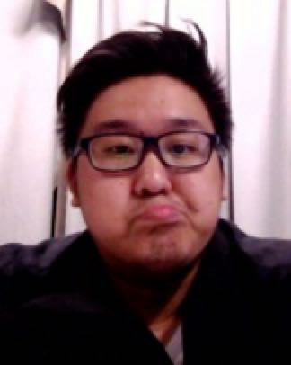
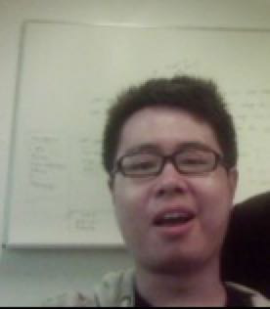
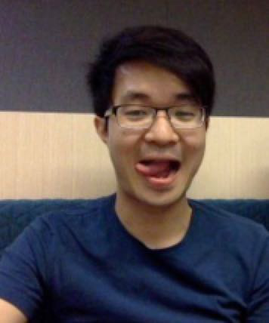
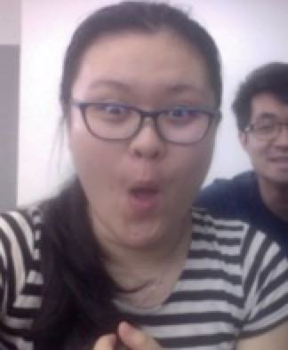
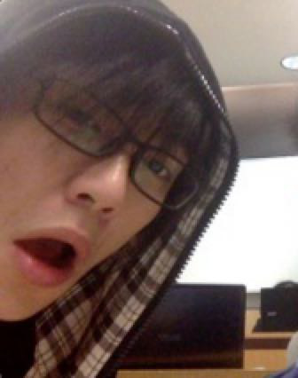
"Alone we can do so little, together we can do so much."

Slide 35

Yong siang
Ivan is a Starbucks addict and he makes funny noises when he sleeps.
He likes to eat llaollao

Slide 36
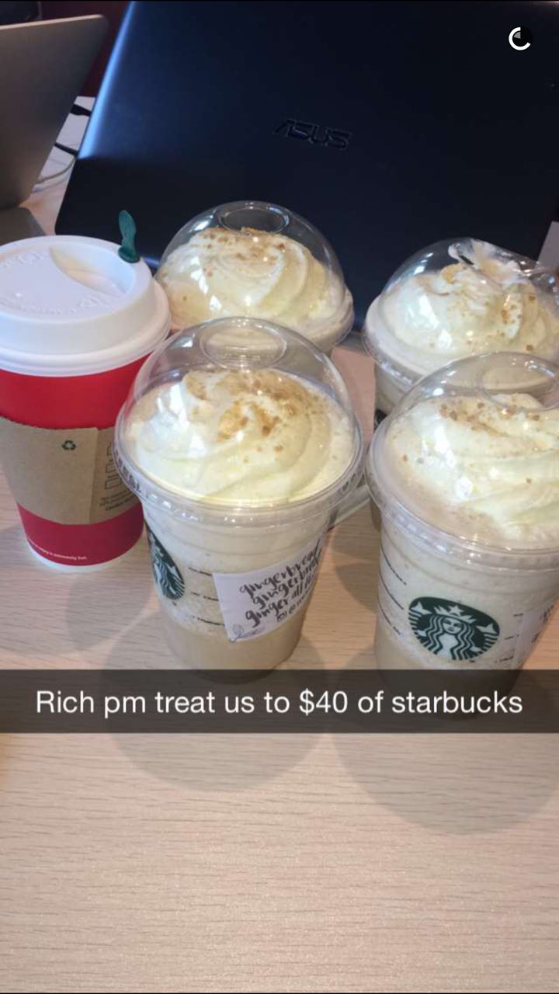
Shuwei
Shuwei is a vegetarian
She is super rich!! Starbucks for everyone!

Slide 37

JASON
Jason eats cigarettes for lunch and dinner
He has a super fan girl in LYL’s class

Slide 38

Wu wei
duplicate.equals(“dumplicate”);
He is a director of drama club

Slide 39

jeremy
Doesn’t need sleep at all
He has cab fund

Slide 40
thank you

